Slide 1
Louis Cendagorta Chief Inspector Suppression & CDA Units
cendagl@fdny.nyc.gov
louis.cendagorta@fdny.nyc.gov

Slide 2
Topics
Fire Statistics
Top 5 FDNY Violations at Construction Sites
Permits needed at Construction Sites
Fire Hose Valves
Temporary Protection – Standpipe/Sprinkler
3 RCNY 115-01 – Extinguisher tags and Duct cleaning decals

Slide 3
2005-2016 CONSTRUCTION SITE FIRES ANNUAL SUMMARY

Slide 4
2005-2016 CDA FIRES MOST COMMON CAUSES
Total Fires

Slide 5
Top 5 FDNY Violations at Construction Sites
#5 – No permit for storage/use of LPG and Compressed Gasses
#4 – No permit for storage/use of flammable or combustible liquids, gasoline, diesel, hydraulic oil, lube oil
#3 – Excessive amounts/obstructions of combustible material
#2 – No Smoking Signs
#1 – Portable Fire Extinguishers missing/not charged

Slide 6
Permits at Construction Sites

Slide 7
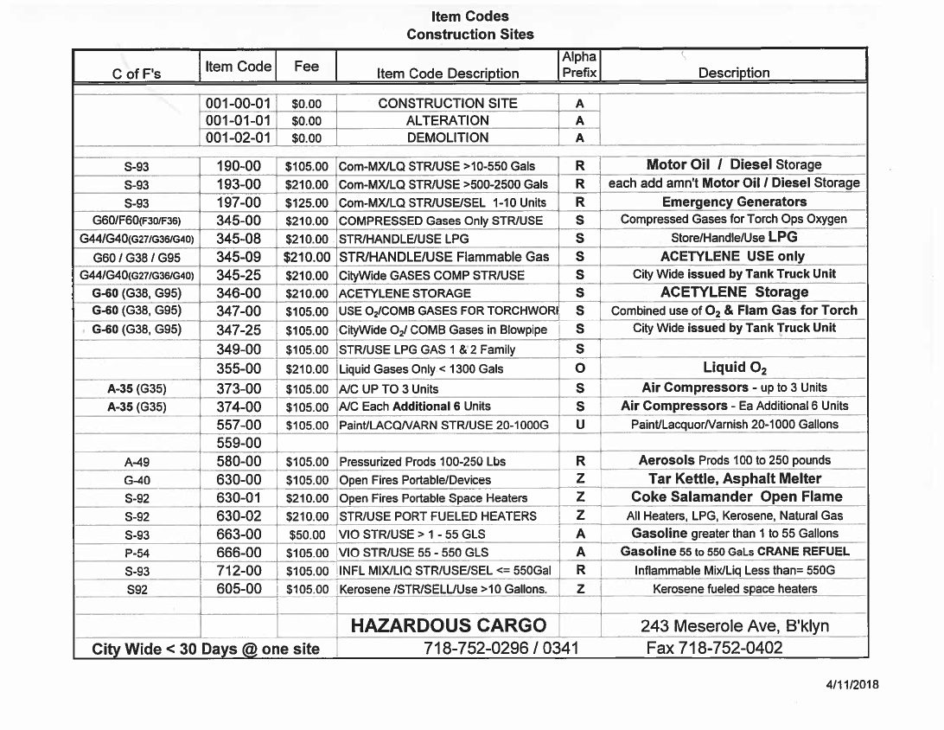

Slide 8
Fire Hose Valves
FC 901.4.5 – Certificate of approval from the FDNY on Fire Department connections, standpipe system hose outlets and pressure reducing valves.
FDNY S.O.P.- Any pressure reducing, regulating, restricting device shall be remove from the hose outlets to proceed with firefighting operations (general statement).

Slide 9
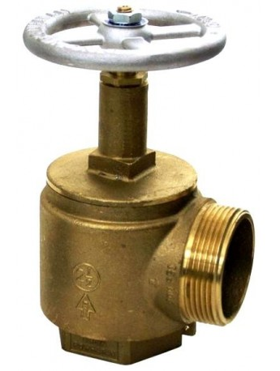
Approved for use in New York City

Slide 10
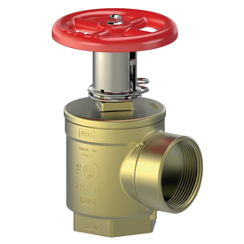
Not Approved in NYC

Slide 11
Temporary Protection
Air Pressurized dry Standpipe system
NYC Building Code 3303.8.1
Temporary loop Sprinkler system
NYC Buildings Bulletin 2017-009
Replaces BB 2012-009
Letter of Notification not required anymore
Must still notify FDNY Dispatchers (FC 901.7)

Slide 12
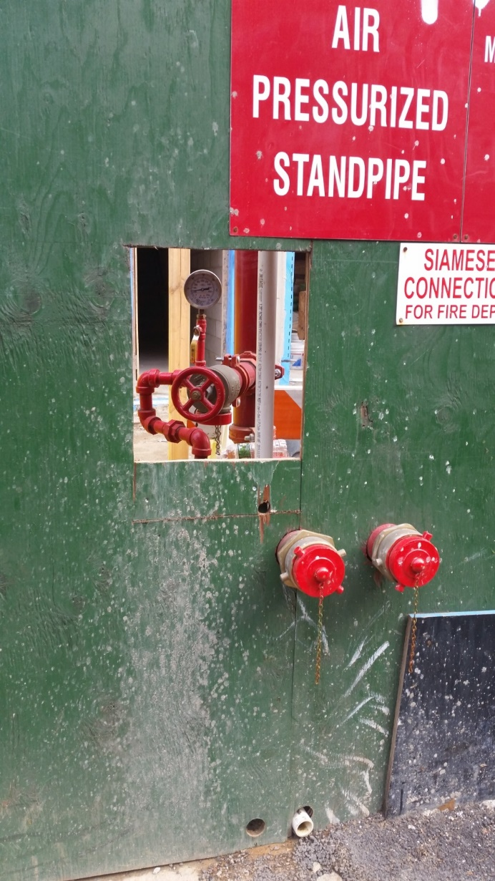

Slide 13
Fire Extinguisher Tags

Slide 14
New Extinguisher Tags
Consistent tag design.
Virtually impossible to reproduce.
Extremely difficult to counterfeit
FDNY controls the issuance of the tags to authorized/insured companies.
More efficient for FDNY Inspectors and the public to verify legitimacy (QR code).
Easily tracked by serial numbers.
Notes:
Starting in July 2018 and will take about a year to completely implement.

Slide 15
New Extinguisher Tags
Extinguisher type
Front of Tag
Hologram
Type of service completed
Month service completed
Year
Company Name/ Logo

Slide 16
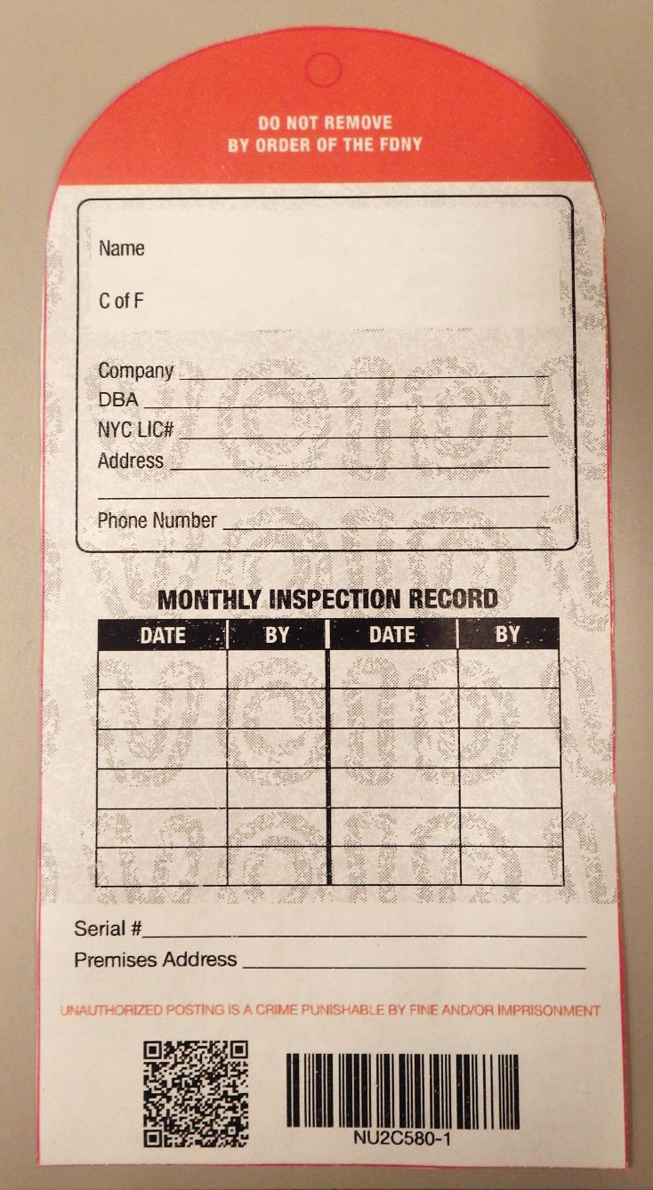
New Extinguisher Tags
COF holder’s information
Company Name
Back of Tag
Quick check (monthly) inspection record
Date and Initial
Extinguisher identification
Location of Extinguisher
Barcode for company to track tags and extinguishers
QR Code to identify approved companies

Slide 17
COMMERCIALCOOKING DECALS

Slide 18
New Commercial Cooking
Cleaning Decals
Consistent decal design
Extremely difficult to counterfeit or use without FDNY approval.
Virtually impossible to reproduce.
Easily tracked by serial numbers.
FDNY controls the issuance of the decals only to authorized/insured companies

Slide 19
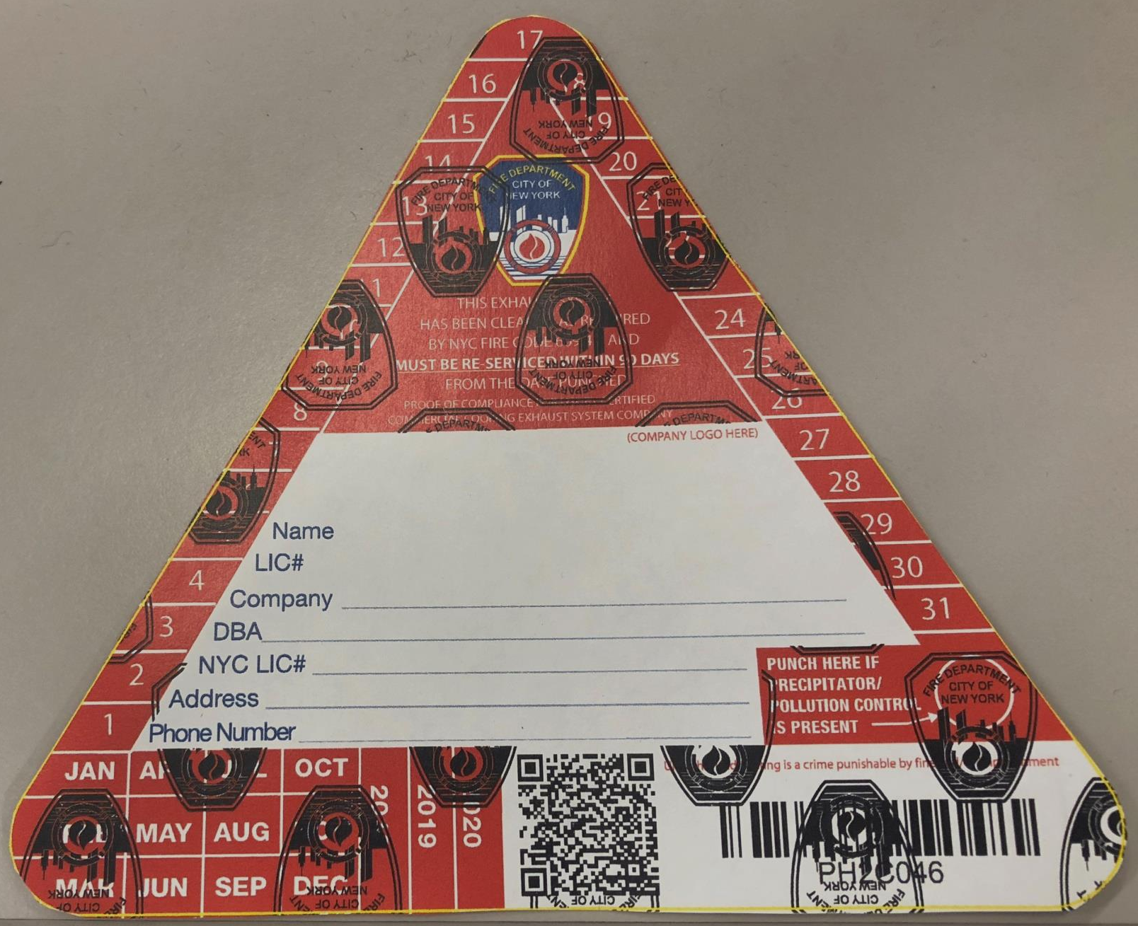
Commercial Cooking Decals
Clear gloss
embossed logo
to cover entire decal
FDNY Logo
Company
COF Holder
Service Date
Company Name/ Logo
Indicates Precipitator or Pollution control
Service Month
Service year
*Other security measures are included
QR Code/Barcode

Slide 20
Fire Dispatch Operations
Bronx
(718) 430-0200
1
Brooklyn
(718) 965-8300
2
Manhattan
(212) 570-4300
3
Staten Island
(718) 494-4296
5
Queens
(718) 476-6200
4

Slide 21
Questions?

