Slide 1
NYC Construction Safety Act & Low-Rise Safety: Industry Perceptions
Peter Simon
CUNY School of Public Health
Capstone Project
12/4/18

Slide 2
Overview/Outline:
Background
NYC Construction Industry Fatal Accident Problem
NYC City Council Proposed Interventions
NYC Construction Industry Perceptions on Interventions
Methods
Email Survey
10 Questions
Results/Findings
3 Response Trends
Recommendations
4 Recommendations for Legislative Interventions

Slide 3
NYC Construction Fatality & Safety Problem
https://www1.nyc.gov/assets/buildings/pdf/2018_SafetyReport_Card_LL196.pdf

Slide 4
NYC Low Rise & Non-Union Construction Sites Identified As High-Risk
http://www.bteany.com/wp-content/uploads/2018/11/OSHA-Report-Card-CY-2018.pdf

Slide 5
Fieldwork - Not For Profit (CSAC) Provided Construction Safety Expertise To NYC Legislatures
The NYC Legislative Process
Step 1: Bill introduction
Council Members work with the Legislation Division to craft a bill that is introduced at stated meetings, where it is assigned to the appropriate Committee.
Step 2: Public hearings
The Committee will hold a public hearing on a bill to obtain feedback from the public and other government entities who may be affected by the bill. This may result in amendments to the bill.
Step 3: Voting
The Committee votes on the bill. If the bill passes the Committee by majority vote, the bill is then sent to the full Council where it will be considered and voted on at a Stated Meeting. The bill must again pass by majority vote.
Step 4: Mayoral decision
After a bill is passed by the Council, it is presented to the Mayor, who has 30 days to either sign the bill into law, veto the bill or take no action. If the Mayor vetoes the bill, it is sent back to the Council. If this happens, the Council can override the Mayor’s veto with a 2/3 vote. If the Mayor doesn’t sign or veto the bill within 30 days, it becomes law.
Step 5: Bill becomes law
Once a bill is signed by the Mayor (or its veto has been overridden by Council), it’s then added to the New York City Charter or Administrative Code.
https://council.nyc.gov/legislation/

Slide 6
2017 NYC Council Proposed Interventions Construction Safety Act: 20+ Bills

Slide 7
Methods – Measuring Construction Industry Perceptions of Proposed Interventions
Email survey utilizing SurveyMonkey.
English and Spanish (Spanish responses combined with English due to a low response rate).
Survey link distributed by CSAC member companies to company construction client/trainee databases.
Distributed to 24,935 email addresses.
Results collected by SurveyMonkey.
Results shared with NYC Council and Industry Regulators.

Slide 8
Survey -10 Question Modeled After Proposed Interventions
Survey Questions: | Survey Responses in Percentages:
1) Which of the following mostly closely describes your job title or affiliation? | Safety Related 64%,
 | Other Professional 14%,
 | Construction Management 12%,
 | Trade Workers 10%
2) Do you find the involvement of a dedicated Safety Professional on a NYC construction project: | Increases 92%
 | Other 5%
 | No Impact 3%
 | Decreases 0%
3) On a NYC New Building or Full Demolition project of 9 stories, how many projects can a single NYC Licensed Superintendent of Construction effectively oversee? | 1 Project 60%
 | 2 Projects 14.53%
 | Other Number of Projects 10.29%
 | 4 Projects 5.03%
 | 3 Projects 4.47%
 | 5 Projects 2.23%
 | 10 Projects 2.23%
 | 6 Projects .56%
 | More Than 10 Projects .56%
4) What is a NYC Licensed Construction Superintendent’s greatest pressure on a project? | Completing Production on Time & Withing Budget 72%
 | Field Supervision 10%
 | Safety Requirements 7%
 | Other 11%
5) Do production staff face pressure to put production ahead of other requirements? | Yes 81%
 | No 11%
 | Other 8%
6) Are current safety training requirements for workers on buildings below 10 stories adequate? | No 56%
 | Yes 31%
 | Don't Know 9%
 | Other 4%
7) Would safety on NYC construction projects under 10 stories improve with input from Safety Professionals? | Yes 91%
 | No 8%
 | Other 1%
8) Does pressure to speed construction production increase safety risk in NYC? | Yes 90%
 | No 6%
 | Other 4%
9) Is 10 Hours of OSHA training sufficient for workers on New York City Construction Sites? | No 64%
 | Yes 26%
 | Other 10%
10) Do NYC project teams want specialized safety inspections assigned to a dedicated Safety Professional? | Yes 64%
 | No 21%
 | Other 15%
3 Response Trends Stood Out

Slide 9
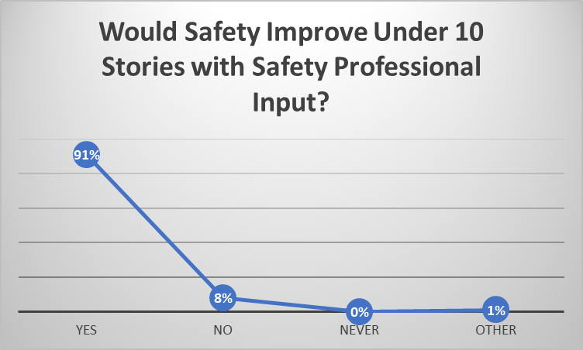
#1 - Involvement of Safety Professional Improves Safety:
High Rise – Safety Pro Required
Low Rise – Safety Pro Not Required

Slide 10
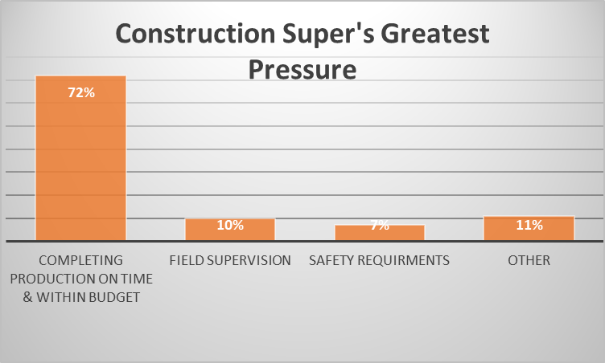
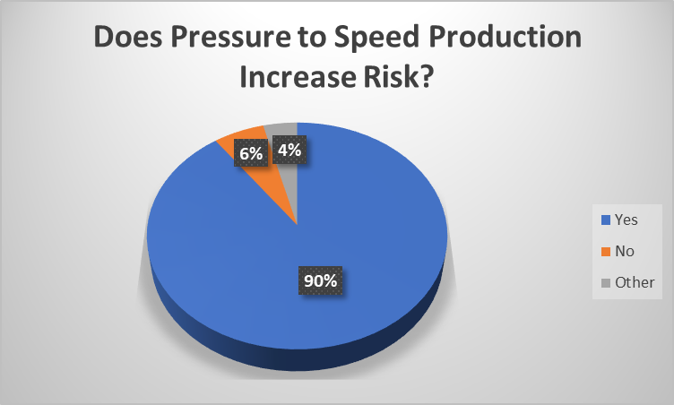
#2 – Production Staff (Construction Superintendents) Not The Most Effective Group For Safety Oversight:
Supers Face Pressure to Complete Production Quickly
Pressure to Increase Speed Increases Risk
Supers Could Be Conflicted Between Production Goals & Safety Goals

Slide 11
#3 – NYC Required Baseline Safety Training Insufficient:
High Rise - 10 Hour OSHA Baseline Required - Insufficient
Low-Rise – No Baseline Training Required - Insufficient

Slide 12
Legislative Recommendations for Interventions:
1) Involve a Safety Professional on Low Rise Construction Sites.
2) Do Not Task Production Staff Only with Safety Responsibilities.
3) Require Baseline Safety Training on Low Rise Sites.
4) Increase Current Baseline Safety Training Beyond 10 Hour OSHA.

Slide 13
Questions?

